Slide 1
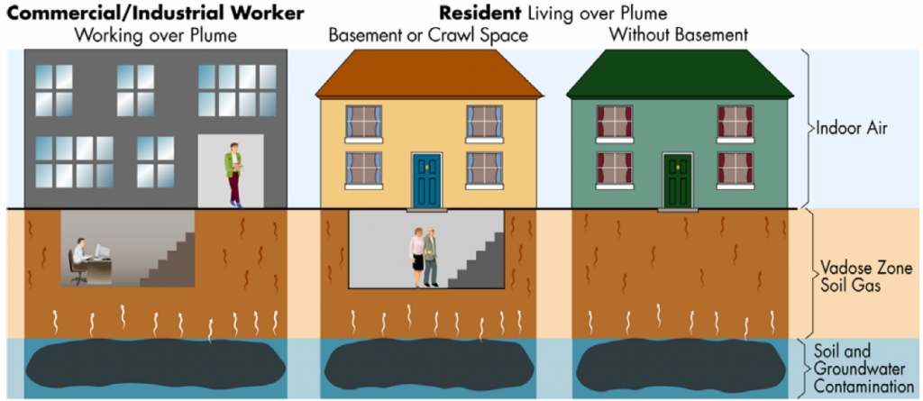
Soil Gas Safe Communities
FACT SHEET
FALL 2022
Is your indoor air healthy? Here is how you can find out.
The Environmental Protection Agency (EPA) in collaboration with the Alaska Department of Environmental Conservation (DEC) are sponsoring a group of researchers from RTI International and Jacobs to partner with community members to conduct pioneering research to better understand the indoor air quality and potential sources of indoor air contamination in downtown Fairbanks, Alaska.
The EPA, RTI, and Jacobs are developing a new concept that building occupants and building owners can use to quickly identify indoor contaminants of concern that may be entering buildings from contaminated soil gas beneath homes and buildings. The results can then be used to inform health and safety risks at a community scale and identify actions residents can take to improve indoor air quality.
Contaminated Soil Gas
Adapted from ITRC, https://vim-1.itrcweb.org/introduction-to-vi-mitigation-fact-sheets/
SOIL GAS
POTENTIAL FOR VAPOR INTRUSION
Soil gas is the gas underground between solid soil particles. It is above the water table and can be contaminated with volatile organic compounds (VOCs), such as dry cleaning solvents or gasoline, resulting from a chemical spill, leak or improper disposal. Naturally-occurring sources such as radon, may also contaminate soil gas.
Depending upon each building’s construction and ventilation, soil vapors can rise through small cracks in foundations and other openings into the building. This migration-exposure pathway is called vapor intrusion.
The potential for vapor intrusion typically happens at a community-scale. For example, a groundwater contamination plume hundreds of yards long may be underneath dozens of buildings.
Buildings with basements, cracked floors, stone foundation walls, dirt floors or crawlspaces may be affected by vapor intrusion.
Indoor air concentrations will vary by building and over time, by occupant behavior, weather, and season. Soil gas/vapor concentrations are typically much higher in the subsurface than those found in indoor air.

Slide 2
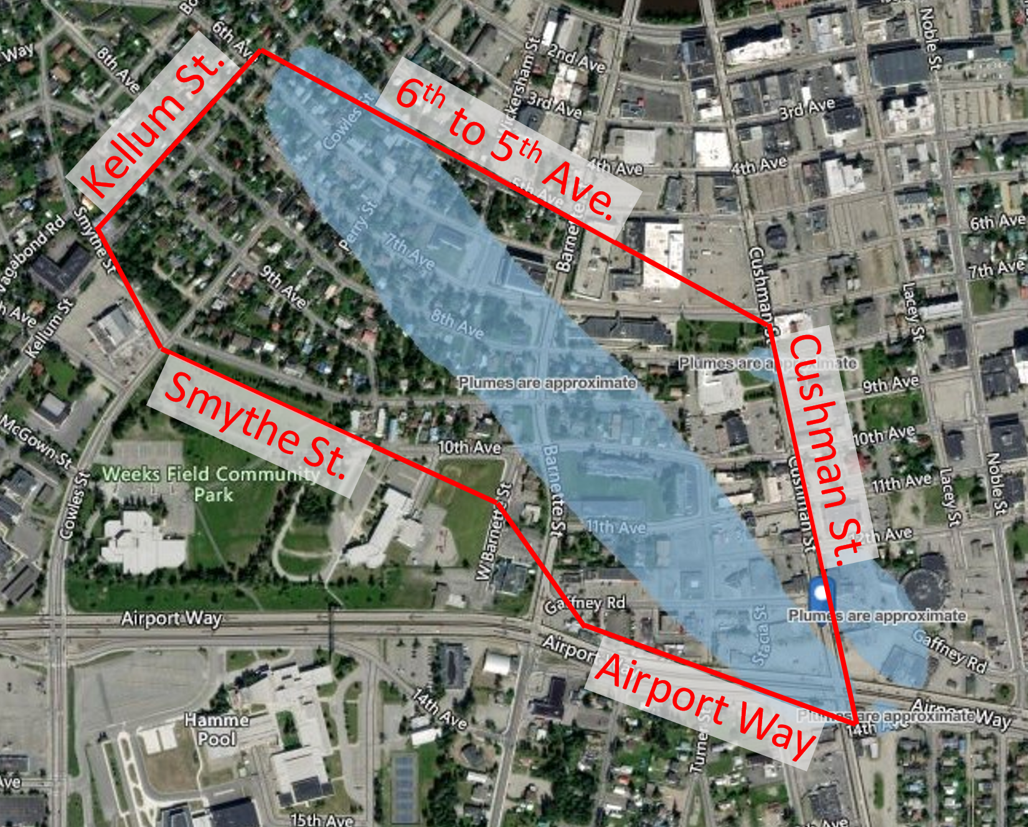
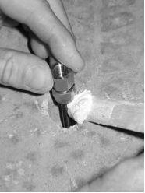
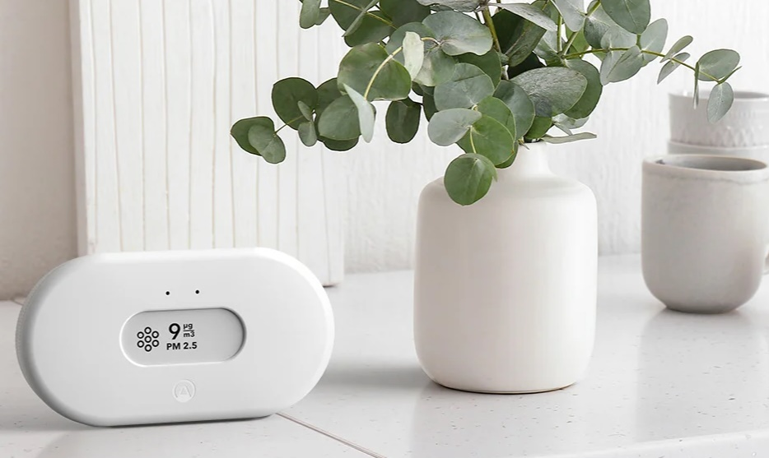
SOIL GAS SAFE COMMUNITIES: FAIRBANKS, ALASKA
STUDY AREA
VOCs and naturally occurring radon gas have been identified in the subsurface in your community. The known contamination source is the Gaffney West VOC plume (area in blue). DEC has monitored the groundwater plume since 1997 and also investigated indoor air quality for dry cleaning chemicals. EPA would like to further investigate the area to know more about vapor movement in this region.
EPA is seeking 30 volunteer homes (specifically single-family homes and ground-floor residences of multi-unit buildings) within the area outlined in red (see map at right) to schedule a free soil gas and indoor air screening of their properties to assess the poten­tial for indoor air health impacts.
SAMPLE COLLECTION
The air samplers are small and will be placed in ‘out of the way’ breathing zones. The AirThings sampler is about the size of an alarm clock and shows the radon concentration on the screen.
Subslab samples will be collected by drilling a small hole (about 1 inch) into an inconspicuous location on the floor (such as a closet) and installing a vapor pin. The hole will be capped after sample collection.
Winter 2022 – Spring 2024: EPA would like to collect indoor air and subslab or exterior soil gas samples at various times to determine if vapor intrusion is occurring, and how the indoor air quality varies over time. VOCs and naturally occurring radon gas will be measured to assess indoor air quality, along with particulate matter, carbon dioxide, temperature, humidity, and pressure.
A local technician will seek written consent from residents and building owners to enter the property and will work with residents to identify good times to place 1 sampler in the basement/crawlspace and 1 on the first floor.
The technician will return occasionally, with the resident’s permission, to collect samples during the study. Follow-up visits should last about 10 minutes.
Results will be shared with building owners and residents after the study is complete.
Air sampler hanging from the ceiling.
AirThings sampler.
Vapor pin
TO SCHEDULE A FREE SCREENING
TO LEARN MORE
PLEASE CONTACT:
Madeline Collins, Jacobs AK
Email: madeline.collins@jacobs.com
Phone: 618-975-0323
For more information about the Soil Gas Safe Communities project,
Email us at soilgassafe@rti.org or visit https://soilgassafe.rti.org/
Gaffney VOC Plume: https://dec.alaska.gov/spar/csp/sites/gaffney/
Vapor Intrusion in Alaska: https://dec.alaska.gov/spar/csp/faq/vapor-intrusion/
Radon in Alaska:
https://dggs.alaska.gov/pubs/id/30163
https://dggs.alaska.gov/hazards/radon.html

